Slide 1


Clustering hospitals

Slide 2
Outline
What is clustering?
Why cluster hospitals for Zorgdomein?
Clustering hospitals for Zorgdomein
Exploring data
Engineering features
Choosing a clustering algorithm
Usage of clusters

Slide 3
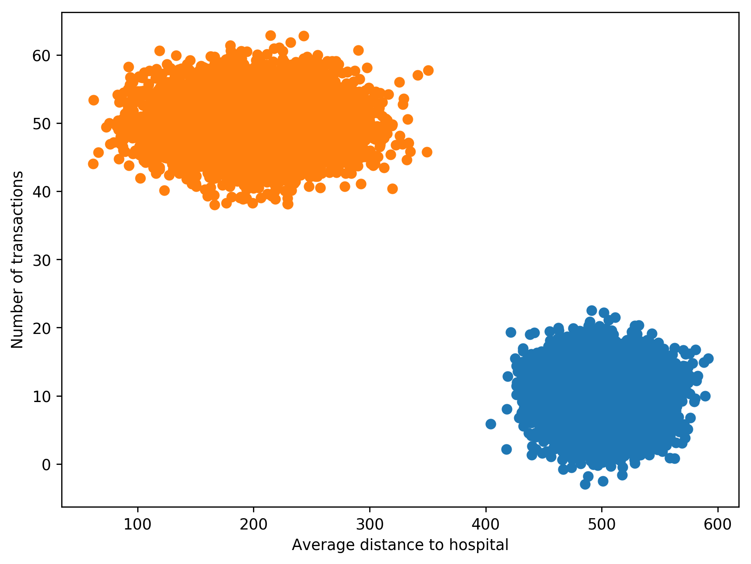
What is clustering?
Also called unsupervised learning, sometimes called classification by statisticians and sorting by psychologists and segmentation by people in marketing
Organizing data into classes such that there is high intra-class similarity and low inter-class similarity
Finding the class labels and the number of classes directly from the data (in contrast to classification).
Finding natural groupings among objects.

Slide 4
Why cluster hospitals for Zorgdomein?
To give hospitals insight into market performance
Make hospitals comparable over different dimension like size, type of care and region served
To give Zorgdomein insights in application usage by clients
Identify opportunities in connecting hospitals to GP's (and vice versa)
Identify underuse of application
Identify hospital types (specialist/local hospital/...) and support them accordingly

Slide 5
Dataset exploration
Dataset
14.7 million records/transactions
88 hospitals
18 columns
960 days
approx. 3.8 GB on disk
Example of available columns
Transaction date(time)
Type of referral
Sender
ID of person
ID of organization
Postal code
Receiver
Location
ID/Name
Healthcare product
Delivery time
Specialization
Application path usage
(e.g. Beeldvormend > Echo > Bloedvaten)

Slide 6
Feature engineering
Create features which naturally define a hospital in its attributes or behavior.
Features should fit intended use of clusters.
These can be thought of from the view of either Zorgdomein, patient, doctor or hospital.
Numerical features are required when applying the popular k-means clustering algorithm.

Slide 7
Possible features
To approx. distances which patients (need to) travel to hospital
(Normalized) number of transactions per 'sender-hospital distance category' (e.g. nearby vs long-distance)
To define specialization of Hospital from medical perspective
(Normalized) number of transactions per healthcare specialization
To define (market) size of hospital
Total number of transactions in last X days
To define familiarity of hospital with referrers (GP's)
Total number of senders (doctors) in last X days per sender (group)
To define hospital with capacity issues
Average/median lead time per specialization in last X days

Slide 8
Choosing a clustering algorithm
Things to note
Relatively small set of hospitals in data (n=88),
Main types of clustering algorithms are: hierarchical clustering and non-hierarchical clustering algorithms.

Slide 9
Measuring performance
Stability of clusters
Visual inspection (not feasible in n-dimensional space, where n > 3)
Usability of clusters (rather vague)

Slide 10
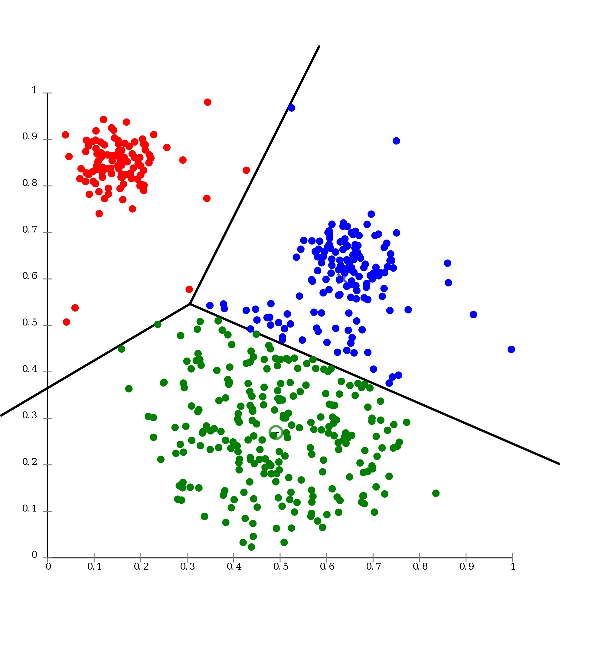
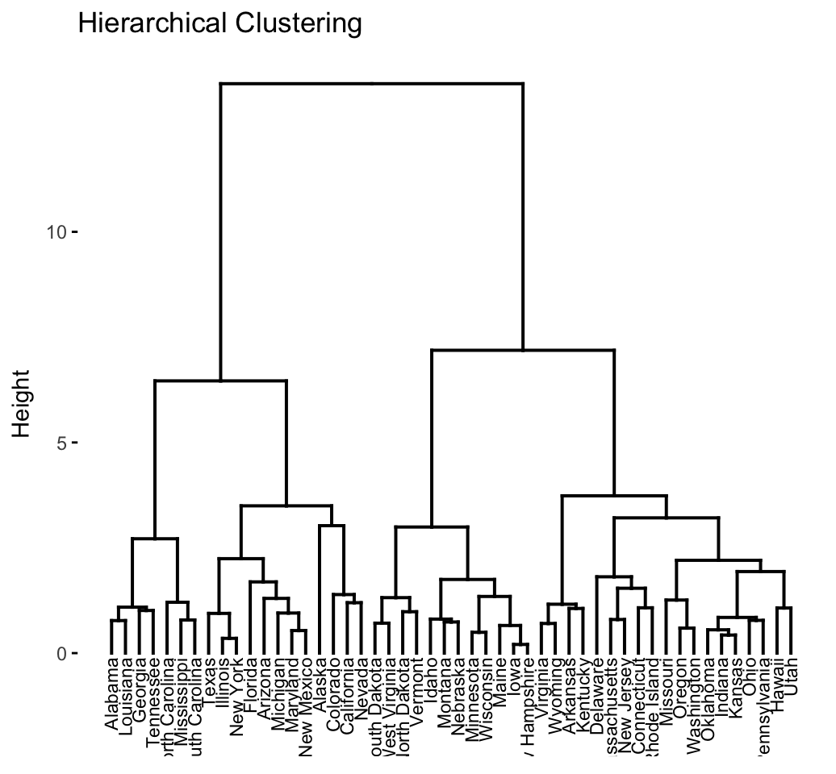
Non-hierarchical clustering and hierarchical clustering
More info: https://www.umass.edu/landeco/teaching/multivariate/schedule/cluster1.pdf

Slide 11
Choosing a clustering algorithm: K-means clustering
Main idea
Cluster data into k-clusters by minimizing within cluster variance (SSE). Usually a distance measure like the Euclidean distance is used. K-means is a well known and widely used non-hierarchical clustering algorithm.
General issues
Sensitive to scale (change scale -> different outcome)
Will find cluster even if they do not exist (will include every data point in a cluster)
Euclidean distance measure suffers from 'curse of dimensionality'
(Main) parameters to tune
Number of clusters
Tips
Initialization procedure: k-means++
Consider using PCA for dimensionality reduction to improve perfomance
Choosing number of clusters can be done manually (if visually possible) or by applying the 'elbow-method' (not always possible). The intended purpose of the clusters should always be kept in mind.
Visualisation: https://www.naftaliharris.com/blog/visualizing-dbscan-clustering/

Slide 12
Choosing a clustering algorithm: HDBSCAN
Main idea
Hierarchical density-based spatial clustering of application with noise. Received a 'test-of-time award' from KDD in 2014.
Advantages
Robust to outliers
No need for a priori knowledge on number of clusters
(Main) parameters to tune
Minimum cluster size
Visualisation: https://www.naftaliharris.com/blog/visualizing-dbscan-clustering/

Slide 13
Technical considerations for analysis
Use SQL selection (AWS Athena) for data-enriching, imputation and filtering the data-set which you want to analyze. (in comparison of doing locally)
Dataset might be too large for memory when prepping (3.8 GB on disk). When this is the case, I recommend streaming data locally, using distributed computing solutions like Dask and Apache Spark or simply subsetting data.

Slide 14
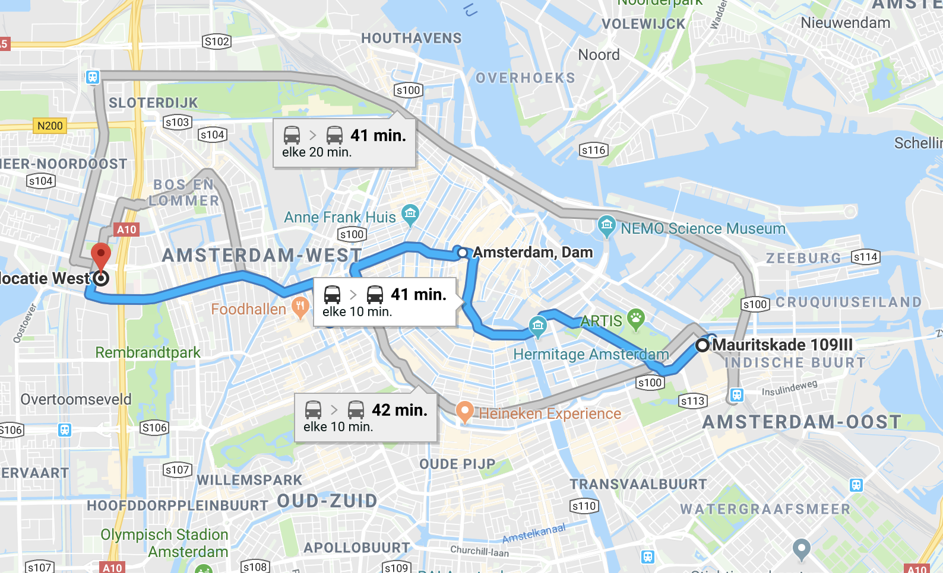
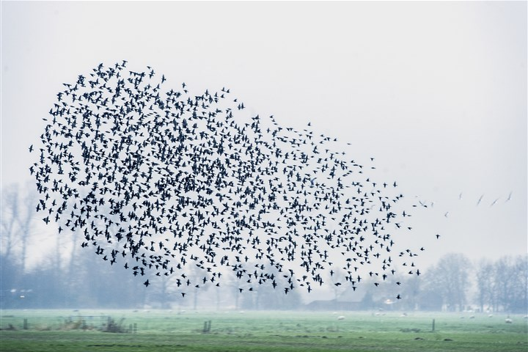
Data enrichment considerations
Geo-location data
e.g. distances (travel time to hospital)
CBS Open Data
e.g. population structure (age/birth rates/immigrants/...)

